Slide 1
Paper Presentation
Yishuo Wang
108533945

Slide 2
Paper Topic
Main Paper:
Structure-Texture Decomposition of Images with Interval Gradient
Related Paper
Guided Image Filtering

Slide 3
Structure-Texture Decomposition of Images with Interval Gradient
Our goal:
Create a novel filtering-based method for structure –texture decomposition.
Input: an image (with structure and texture)
Output: an image that its texture has been suppressed, while preserving the structure of the original image.

Slide 4



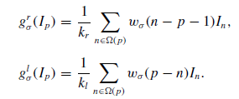

Steps to do the project
First Step: data preparing
1. Computing the Normal Gradient
2. Computing the Interval Gradient
W function here is exponential weighting
Function. Sigma is a scale parameter. The
range in the paper is [2,5], I will use 3

Slide 5
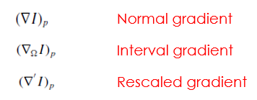


Steps to do the project
3. Computing the Rescaled Gradient (Base on the NG and IG)
Compare the sign of the normal gradient and the Interval gradient to do the gradient rescaling.
Error is 10^-4 in the project. For protecting the bot to be 0.

Slide 6

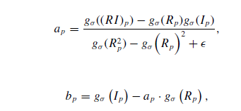



Second Step: Rebuild the new Image
Temporary signal:
Ps1: For the ap and bp, paper said they satisfy
the equation to get the min
Computer process:
Ps2: In the ap, bp, g function is the gaussing
Smoothing function.
New Image:
epsilon range in the paper is [0.01^2,0.03^2], I will use
0.03^2. ps: if bigger than the range, will be too smooth.

Slide 7
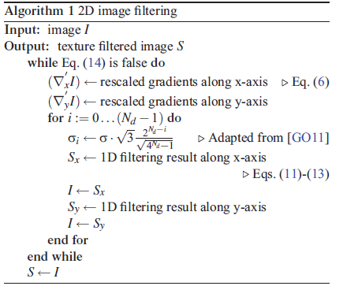


Algorithm
Iteration times, range is 3~5
the standard deviation of the desired kernel(We use gaussing smooth)
standard deviation for the kernel used in each iteration

Slide 8
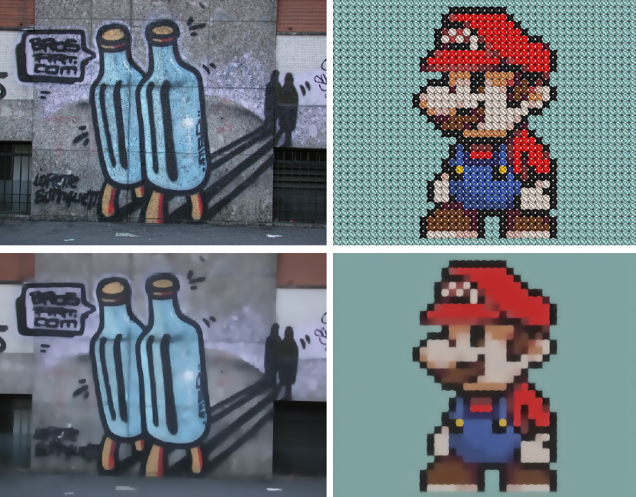
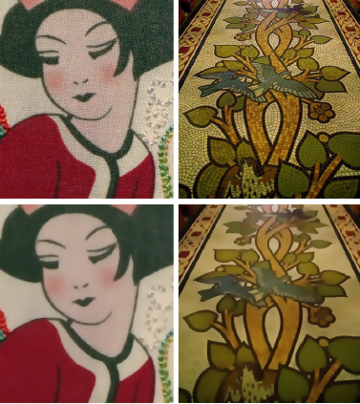
Sample input and output of the project

Slide 9
Guided Image Filtering
Goal:
To design a new edge-preserving filter using guidance image I.
Input: input image p, guidance image I.（I and p can be same）
Output: output image q, we assume q is a linear transform of I.

Slide 10
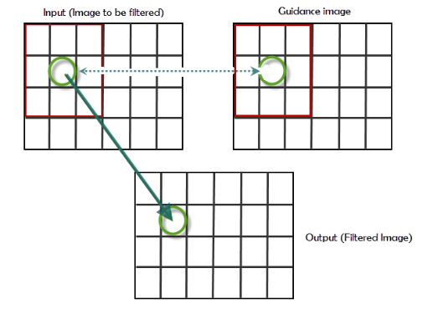
Guided Image Filtering description
Paper performs edge-preserving smoothing on an image p, using the content of guided image I, to influence the filtering. The guided image can be the image itself, a different version of the image, or a completely different image. Guided image filtering is a neighborhood operation.

Slide 11
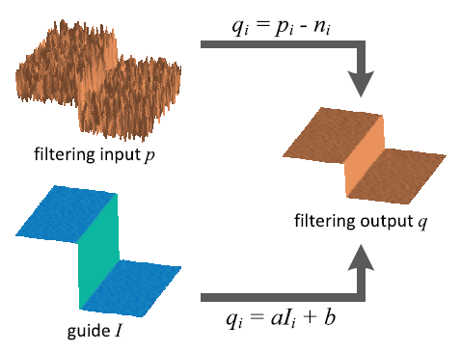

This is the main model of the filter.
Qi is the ith output pixel.
Pi is the ith input pixel.
Ni is the noise part of the ith pixel, so it is the part of the Pi.
Ii is the ith pixel of the guide image.

Slide 12
Two cases for the guided image I
Same as the input image p
Different image
If the guided image I is same as the image p to be filtered, the structures are the same—an edge in original image P is the same in the guidance image I.
If the guided image I is different, structures in the I will impact the filtered image q, in effect, imprinting these structures on the original image p. This effect is called structure transference.

Slide 13




(4) explanation:
Our goal is filtering the noise (which is n here). So for the eq4, we need to minimize the equation. So we need to find a linear coefficients ak and bk to let the eq4 to be minimized. Author use linear regression to get this.
Depends on 3,
Build eq 4.

Slide 14
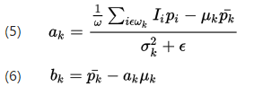



(5) Here, and are the mean and variance of I in wk (RGB divided). |w| is the number of pixels in wk, and wk is the local window.(size is 3x3).
(6) Is the mean of p in wk.
The qi is the filtered image that that paper want!!!

Slide 15
Relation between two paper
Main paper is motivated by the second paper’s theory.
Main Paper
Related Paper
1. get Normal Gradient
2. get Interval Gradient
3. get the Rescaled Gradient
4 computing the temporary signal R(temporary image)
1. input image p
2 guided image I
What R did in main paper is kind same as the
Guided image I in the related paper!!!

Slide 16
Main paper:
Related paper:
1.
Guided image I
2.
Minimized
Minimized
Window is
Different.
1D 2D
3.
1 x 2*ceil(3*sigma)+1
3x3
4.
New Image:

